Slide 1


Slide 2
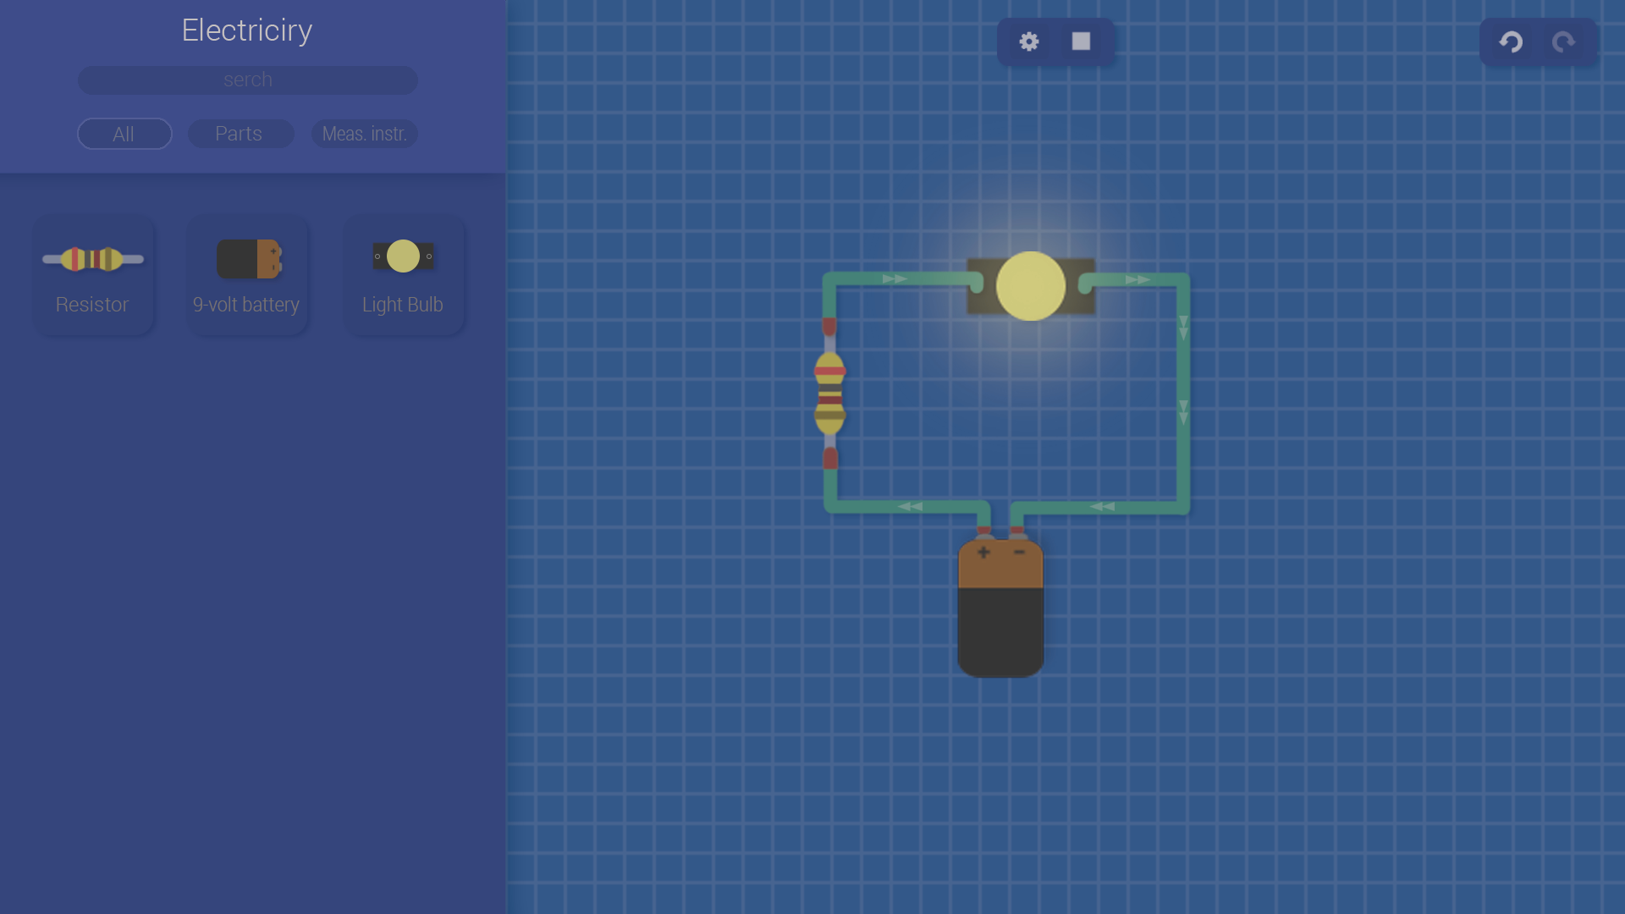

Slide 3
Class Section
Class Button
Class Bulb
Class ItemBrick
Class Resistor
Class 9Volt
Class Wire

Slide 4
Class Interactive
Class Section
Class ItemBrick
Class Item
tipedef Button
Class Parts
Class Power
Class Measuring
Class Bulb
Class Resistor
Class NineVolt

